Slide 1

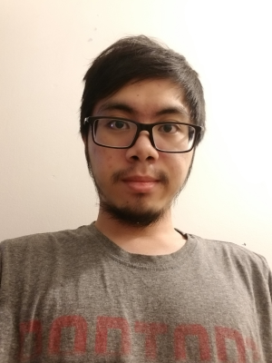
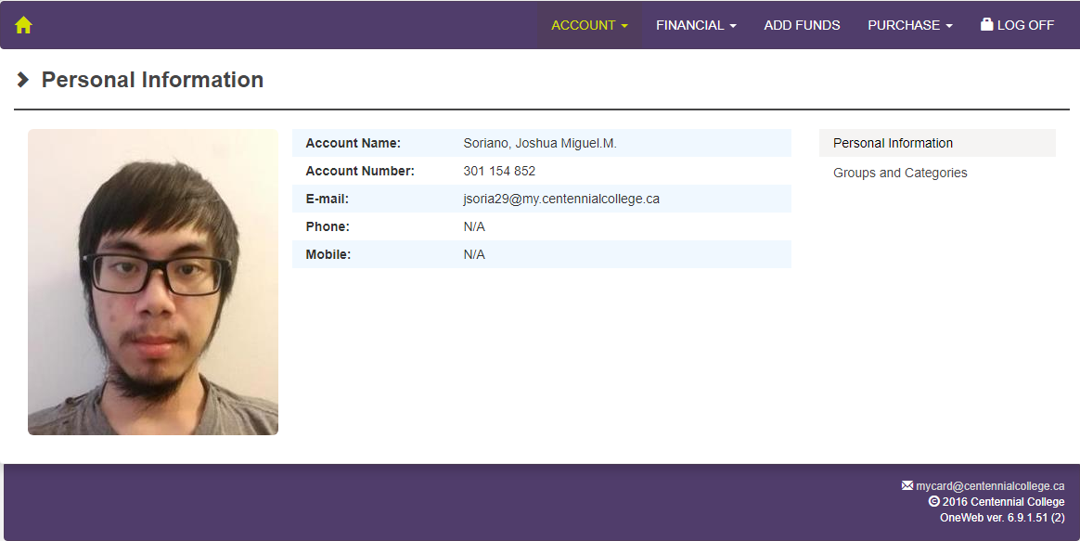
Joshua Miguel Soriano
301154852 – Assignment 1 - Express Portfolio
Web Application Development – COMP229

Slide 2
About Me
Born in Manila, Philippines
Enrolled in Software Engineering Tech – AI COOP
Why? Machine learning and AI’s are cool
Lots of opportunities
Robots
Some hobbies include playing video games, watching movies

Slide 3
Projects & Interests
I am interested in learning more about machine learning
I want to create my own AI
I want to experiment with neural networks and deep learning algorithms
No current projects, but I would like to try creating a small phone game

Slide 4
The Future
I see myself in the work force
I would like to be traveling around the world
I would be working with AI and machine learning, hopefully

